Slide 1

Sprint 5 Demo
Green and Yellow teams
Notes:
JANUARY 12

Slide 2

Progress
PROCESS:
Prioritization
UX Testing
UX Pyramid Analysis
FUNCTIONAL:
Slider
Disclaimer
Payment Page
Category Navigation
Notes:
Process and functional side of the PROJECT process steps –me and luke
Functional features - jop

Slide 3

Prioritization
MUST
Set preferences
Scan Product
SHOULD
Edit basket
COULD
WOULD NOT
Warnings
View basket
Hide product categories
Locate products
Navigation routes
Locate categories using AR
Save coordinates of product categories
AR initialization loading screen
Shopping list
Missed product reminder
Recipe suggestions
Voice navigation
Product category search
Checkout page
Payment option
Product recommendations

Slide 4

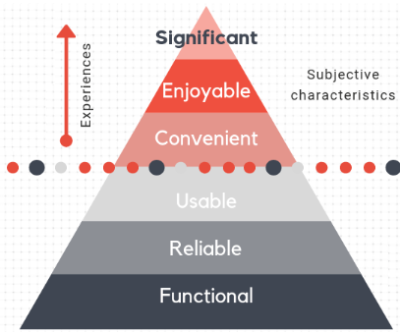
UX Pyramid Analysis
Notes:
1. Functional – MVP, preferences, scanning, basket
2. Reliable – client’s API, cross platform (IOS/Android)
3. Usable – frequent feedback, design updates to match Jumbo guidelines, UX testing
4. Convenient – Improves shopping experience
5. Enjoyable – beautiful design, smooth transitions, gestural commands, high-resolution imagery, sound interactions
6. Significant – personalized preferences make product feel personally useful and enjoyable

Slide 5




Usability Testing
Guide Me
Product Found
Disclaimer

Slide 6

Initial Reactions
“Scanning is fast, I like scanning multiple items.”
“This makes my life so much better!”
“Where can I get this???”
“I would especially love the option to hide the products or categories.”

Slide 7
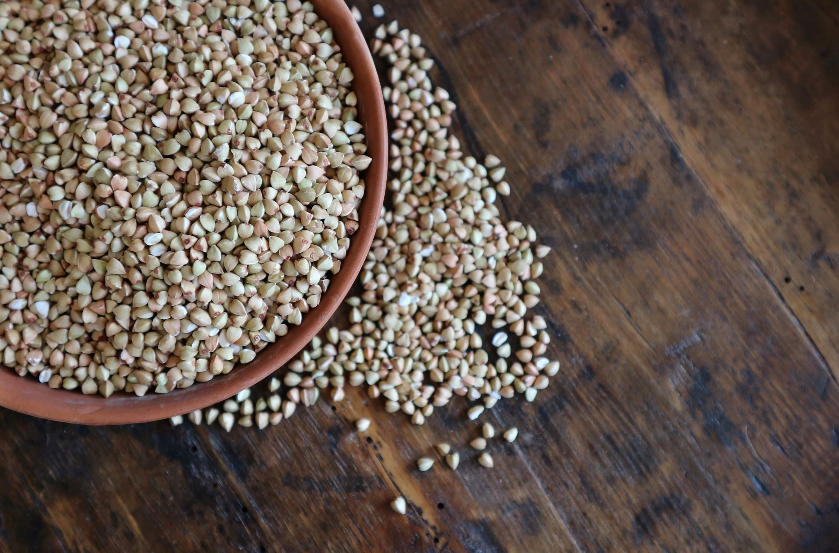
Improvements Needed
Locating payment button
Preferences may require onboarding
Alert twice for same product
Add delay between scans of the same item

Slide 8

Demo

Slide 9






What is next?
More testing
Final tweaks
Deployment / Handover

Slide 10

Feedback

